Slide 1
Development of Coding Protocol
Coding protocol: essential feature of meta-analysis
Goal: transparent and replicable
  description of studies
  extraction of findings

Slide 2
Topics for Coding
Eligibility criteria and screening form
Development of coding protocol
Hierarchical nature of data
Assessing reliability of coding
Training of coders
Common mistakes

Slide 3
Study Eligibility Criteria
Flow from research question
Identify specifics of:
  Defining features of the program/policy/intervention
  Eligible designs; required methods
  Key sample features
  Required outcomes
  Required statistical data
  Geographical/linguistic restrictions, if any
  Time frame, if any
Also explicitly states what is excluded

Slide 4
Study Eligibility Screening Form
Develop a screening form with criteria
Complete form for all studies retrieved as potentially eligible
Modify criteria after examining sample of studies (controversial)
Double-code eligibility
Maintain database on results for each study screened
Example
Notes:
MWL WILL MAKE HANDOUT WITH EXAMPLE BASED ON THE VERSION IN PRACTICAL META-ANALYSIS

Slide 5
Development of Coding Protocol
Goal of protocol
  Describe studies
  Differentiate studies
  Extract findings (effect sizes if possible)
Coding forms and manual
  Both important
Notes:
MWL WILL DO HANDOUT OF SAMPLE CODING ITEM AND ASSOCIATED MANUAL INSTRUCTIONS

Slide 6
Development of Coding Protocol
Iterative nature of development
Structuring data
  Data hierarchical (findings within studies)
  Coding protocol needs to allow for this complexity
  Analysis of effect sizes needs to respect this structure
  Flat-file (example)
  Relational hierarchical file (example)

Slide 7
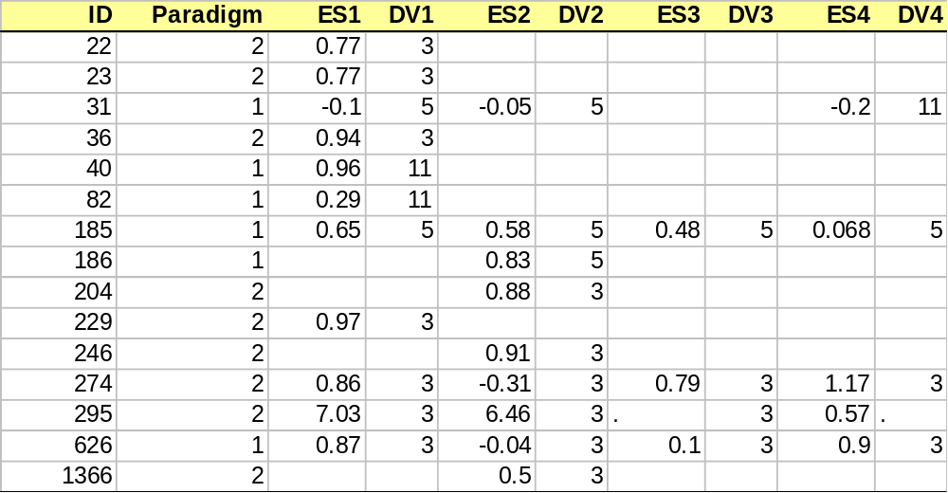
Example of a Flat File
Multiple ESs handled by having multiple
variables, one for each potential ES.
Note that there is only one record (row) per study

Slide 8
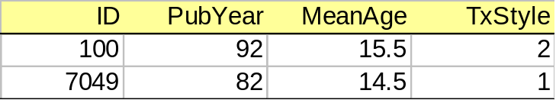
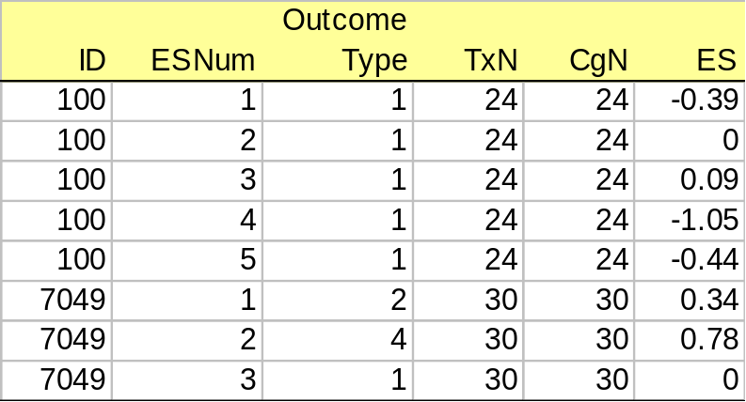
Example of a Hierarchical Structure
Study Level Data File
Effect Size Level Data File
Note that a single record in the file above is “related” to five records in the file to the right

Slide 9
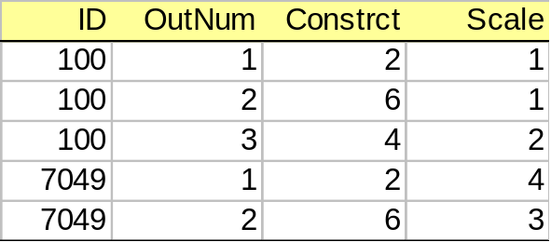
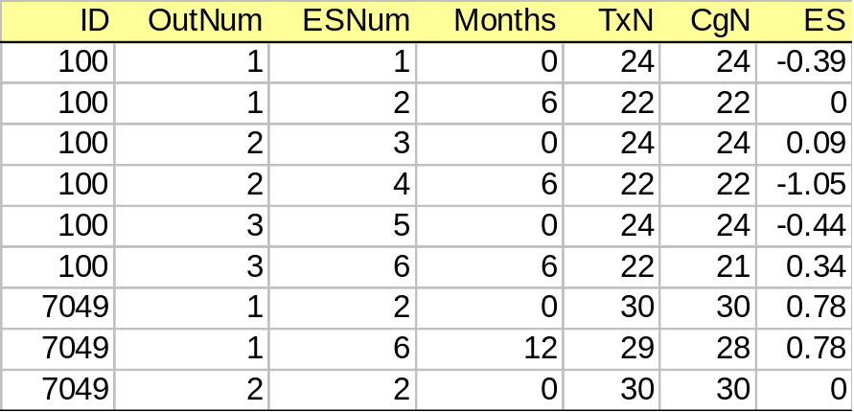
Example of a More Complex Multiple
File Data Structure
Study Level Data File
Outcome Level Data File
Effect Size Level Data File
Note that study 100 has 2 records in the outcomes data file and 6 outcomes in the effect size data file, 2 for each outcome measured at different points in time (Months)

Slide 10
Advantages & Disadvantages of
Multiple Flat Files Data Structure
Advantages
  Can “grow” to any number of ESs
  Reduces coding task (faster coding)
  Simplifies data cleanup
  Smaller data files to manipulate
Disadvantages
  Complex to implement
  Data must be manipulated prior to analysis
  Must be able to select a single ES per study for any analysis
When to use
  Large number of ESs per study are possible

Slide 11
Concept of “Working” Analysis Files
Permanent Data Files
select subset of ESs of
interest to current analysis,
e.g., a specific outcome at
posttest
Study Data File
Outcome Data File
ES Data File
verify that there is only a
single ES per study
create
composite
data file
yes
no
Average ESs, further select
based explicit criteria, or
select randomly
Composite Data File
Working Analysis File

Slide 12

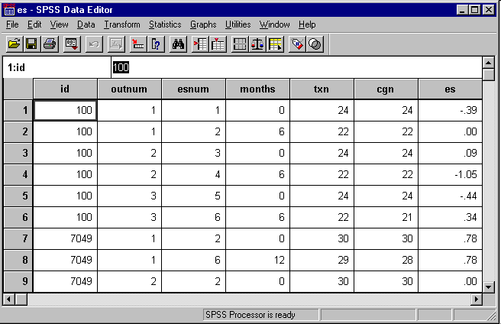
Example: SPSS ES Data File

Slide 13
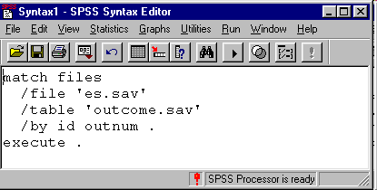
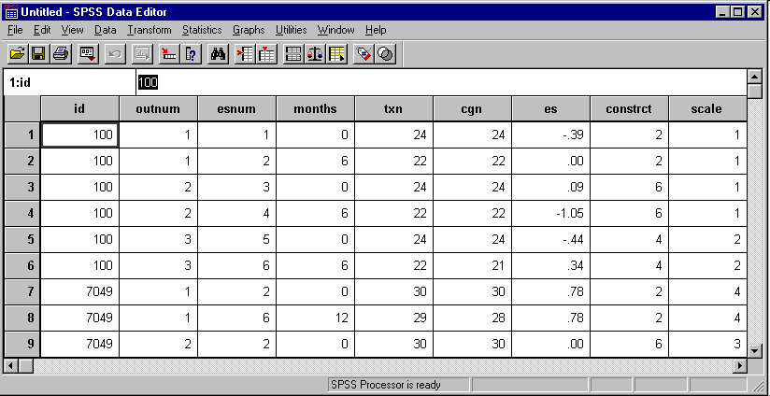
Example: SPSS ES+Outcome Data File

Slide 14
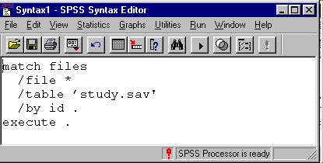

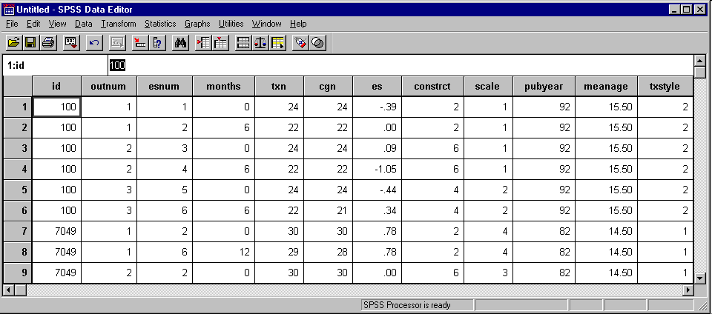
Example: SPSS ES+Outcome+Study Data File

Slide 15
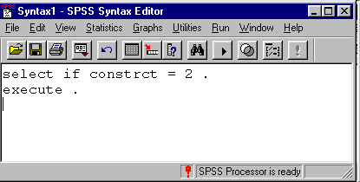

Example: Creating Subset for Analysis

Slide 16
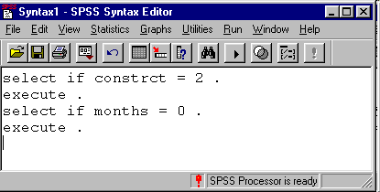
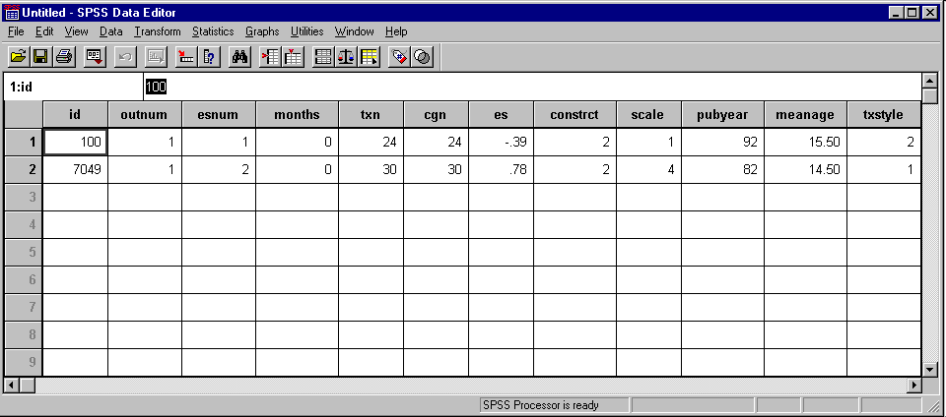
Example: Final Working File for a Single Analysis

Slide 17
Concept of “Working” Analysis Files
Permanent Data Files
select subset of ESs of
interest to current analysis,
e.g., a specific outcome at
posttest
Study Data File
Outcome Data File
ES Data File
verify that there is only a
single ES per study
create
composite
data file
yes
no
Average ESs, further select
based on explicit criteria, or
select randomly
Composite Data File
Working Analysis File

Slide 18
What about Sub-Samples?
What if you are interested in coding ESs separately for different sub-samples, such as, boys and girls, or high-risk and low-risk youth, etc?
  Just say “no”!
    Often not enough of such data for meaningful analysis
    Complicates coding and data structure
  Well, if you must, plan your data structure carefully
    Include a full sample effect size for each dependent measure of interest
    Place sub-sample in a separate data file or use some other method to reliable determine ESs that are statistically dependent

Slide 19
Coding Mechanics
Paper Coding (see Appendix E)
  include data file variable names on coding form
  all data along left or right margin eases data entry
Coding into a spreadsheet
Coding directly into a computer database

Slide 20
Coding Directly into a Computer Database
Advantages
  Avoids additional step of transferring data from paper to computer
  Easy access to data for data cleanup
  Data base can perform calculations during coding process (e.g., calculation of effect sizes)
  Faster coding
Disadvantages
  Can be time consuming to set up
    the bigger the meta-analysis the bigger the payoff
  Requires a higher level of computer skill

Slide 21
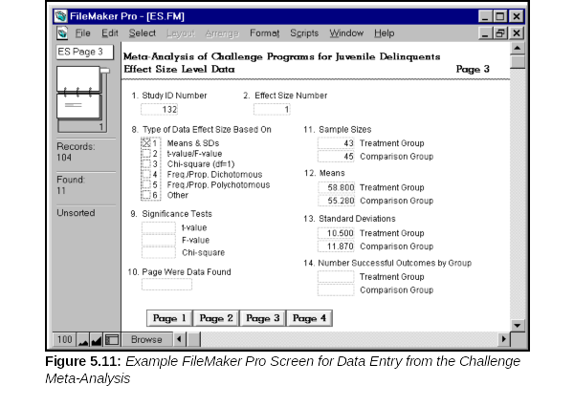
Example of Database with Forms

Slide 22
Assessing Reliability of Coding
Inter-rater reliability and double coding
Intra-rater reliability

Slide 23
Training Coders
Regular meetings (develops normative understandings)
Annotate coding manual
“Specialist” coders

Slide 24
Common Mistakes
Not understanding or planning the analysis prior to coding
Underestimating time, effort, and technical/statistical demands
Using a spreadsheet for managing a large review
Variable names not on coding forms
Not breaking apart difficult judgments

Slide 25
Common Mistakes
Over-coding—Trying to extract more detail than routinely reported
Notes:
Probably some others to add here, but I’ll come back to this. Can always tweak at the last minute.

Slide 26
Comments on Managing the Bibliography
Major activity
Information you need to track
  source of reference (e.g., PsychLit, Dissertation Abs.)
  retrieval status
    retrieved, requested from ILL, etc.
  eligibility status
    eligible
    not eligible
    relevant review article
  coded status
Word processor not up to the task
Spreadsheets are cumbersome
Use a database of some form

